Slide 1
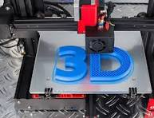
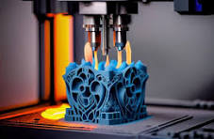
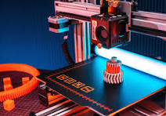
3D PRINTING

Slide 2
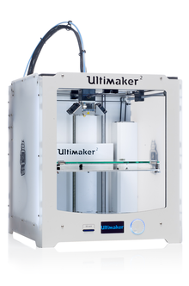
3D printing
3D printing or additive manufacturing is the construction of a three-dimensional object from a CAD model or a digital 3D model. It can be done in a variety of processes in which material is deposited, joined or solidified under computer control,with the material being added together (such as plastics, liquids or powder grains being fused), typically layer by layer.
In the 1980s, 3D printing techniques were considered suitable only for the production of functional or aesthetic prototypes, and a more appropriate term for it at the time was rapid prototyping.As of 2019, the precision, repeatability, and material range of 3D printing have increased to the point that some 3D printing processes are considered viable as an industrial-production technology; in this context, the term additive manufacturing can be used synonymously with 3D printing.
3D printing

Slide 3
Terminology
The umbrella term additive manufacturing (AM) gained popularity in the 2000s,^{[9]} inspired by the theme of material being added together (in any of various ways). In contrast, the term subtractive manufacturing appeared as a retronym for the large family of machining processes with material removal as their common process. The term 3D printing still referred only to the polymer technologies in most minds, and the term AM was more likely to be used in metalworking and end-use part production contexts than among polymer, inkjet, or stereolithography enthusiasts.
By the early 2010s, the terms 3D printing and additive manufacturing evolved senses in which they were alternate umbrella terms for additive technologies, one being used in popular language by consumer-maker communities and the media, and the other used more formally by industrial end-use part producers, machine manufacturers, and global technical standards organizations. Until recently, the term 3D printing has been associated with machines low in price or capability

Slide 4
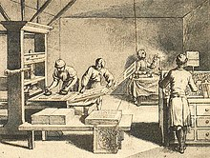
History
1940s and 1950s
The general concept of and procedure to be used in 3D-printing was first described by Murray Leinster in his 1945 short story "Things Pass By": "But this constructor is both efficient and flexible. I feed magnetronic plastics — the stuff they make houses and ships of nowadays — into this moving arm. It makes drawings in the air following drawings it scans with photo-cells. But plastic comes out of the end of the drawing arm and hardens as it comes ... following drawings only" ^{[12]}
It was also described by Raymond F. Jones in his story, "Tools of the Trade", published in the November 1950 issue of Astounding Science Fiction magazine. He referred to it as a "molecular spray" in that story.
1970s
In 1971, Johannes F Gottwald patented the Liquid Metal Recorder, U.S. patent 3596285A, a continuous inkjet metal material device to form a removable metal fabrication on a reusable surface for immediate use or salvaged for printing again by remelting. This appears to be the first patent describing 3D printing with rapid prototyping and controlled on-demand manufacturing of patterns.

Slide 5
Benefits of 3D printing
Additive manufacturing or 3D printing has rapidly gained importance in the field of engineering due to its many benefits. Some of these benefits include enabling faster prototyping, reducing manufacturing costs, increasing product customization, and improving product quality.
Furthermore, the capabilities of 3D printing have extended beyond traditional manufacturing, with applications in renewable energy systems.3D printing technology can be used to produce battery energy storage systems, which are essential for sustainable energy generation and distribution.
Another benefit of 3D printing is the technology's ability to produce complex geometries with high precision and accuracy. This is particularly relevant in the field of microwave engineering, where 3D printing can be used to produce components with unique properties that are difficult to achieve using traditional manufacturing methods.

Slide 6
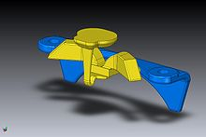
General principles
Modeling
3D printable models may be created with a computer-aided design (CAD) package, via a 3D scanner, or by a plain digital camera and photogrammetry software. 3D printed models created with CAD result in relatively fewer errors than other methods. Errors in 3D printable models can be identified and corrected before printing.^{[57]} The manual modeling process of preparing geometric data for 3D computer graphics is similar to plastic arts such as sculpting. 3D scanning is a process of collecting digital data on the shape and appearance of a real object, and creating a digital model based on it.
CAD models can be saved in the stereolithography file format (STL), a de facto CAD file format for additive manufacturing that stores data based on triangulations of the surface of CAD models. STL is not tailored for additive manufacturing because it generates large file sizes of topology-optimized parts and lattice structures due to the large number of surfaces involved. A newer CAD file format, the additive manufacturing file format (AMF), was introduced in 2011 to solve this problem. It stores information using curved triangulations

Slide 7
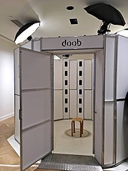
Printing
Before printing a 3D model from an STL file, it must first be examined for errors. Most CAD applications produce errors in output STL files,of the following types:
holes
faces normals
self-intersections
noise shells
manifold errors
overhang issues

